Slide 1


Introduction to Molecular Biology
Lab 11
Dr. Rawa Abdul Redha Aziz
Ph.D Antibiotics/ Molecular biology

Slide 2
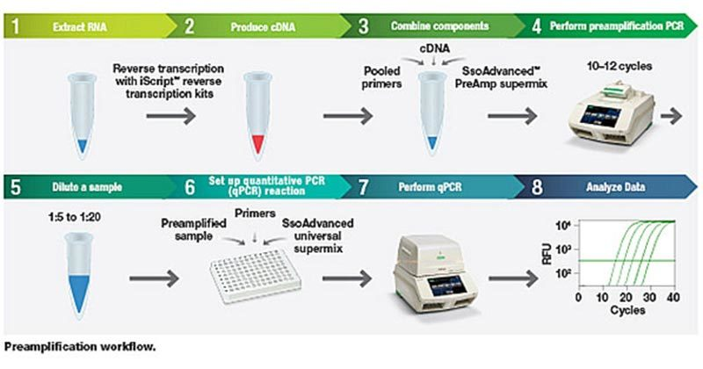
Real Time PCR

Slide 3
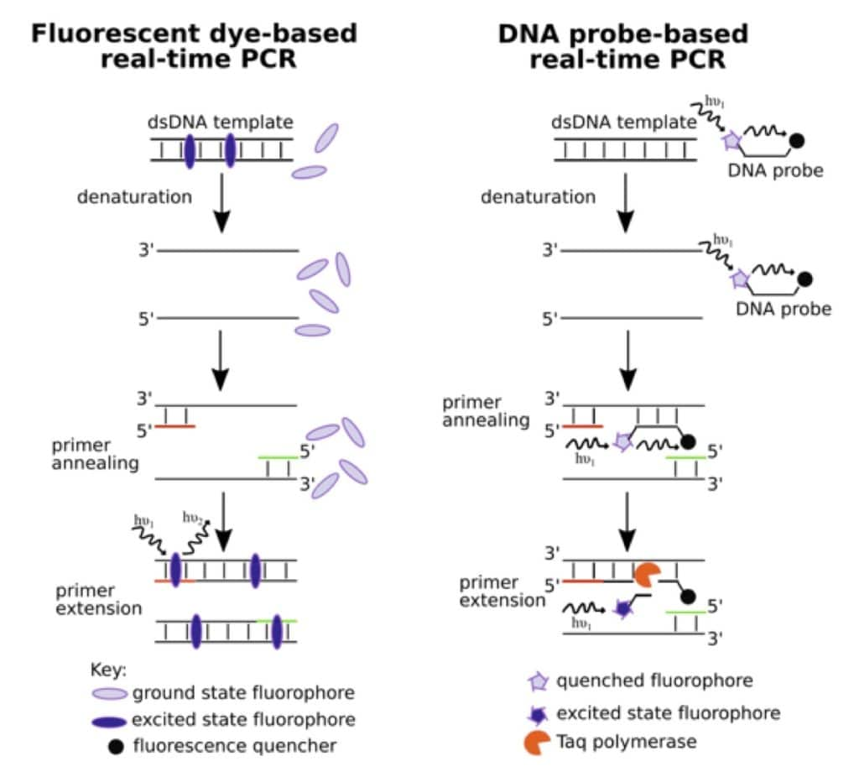

Slide 4

Any Question?

